Slide 1
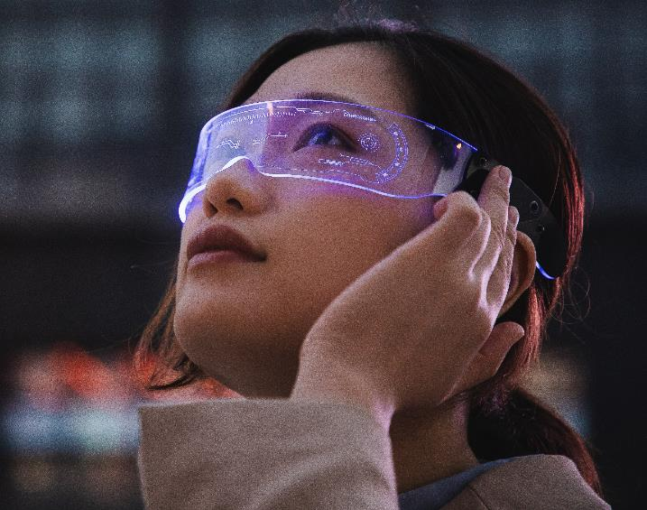
VR Gaming Market analysis Presentation
By: Humza Sheikh

Slide 2
Shout out
I want to say a special thanks Mr. Yo, Sana, Katrina, Ail for helping me with this project and providing their support.
Mr. Yo providing the tools for me to succeed
Sana and Katrina providing the facilitator guide and rubrics
Ail for technical support
Notes:
I want to say a special thanks Mr. Yo, Sana, Katrina, Ail for helping me with this project and providing their support.
Mr. Yo providing the tools for me to succeed
Sana and Katrina providing the facilitator guide and rubrics
Ail for technical support

Slide 3

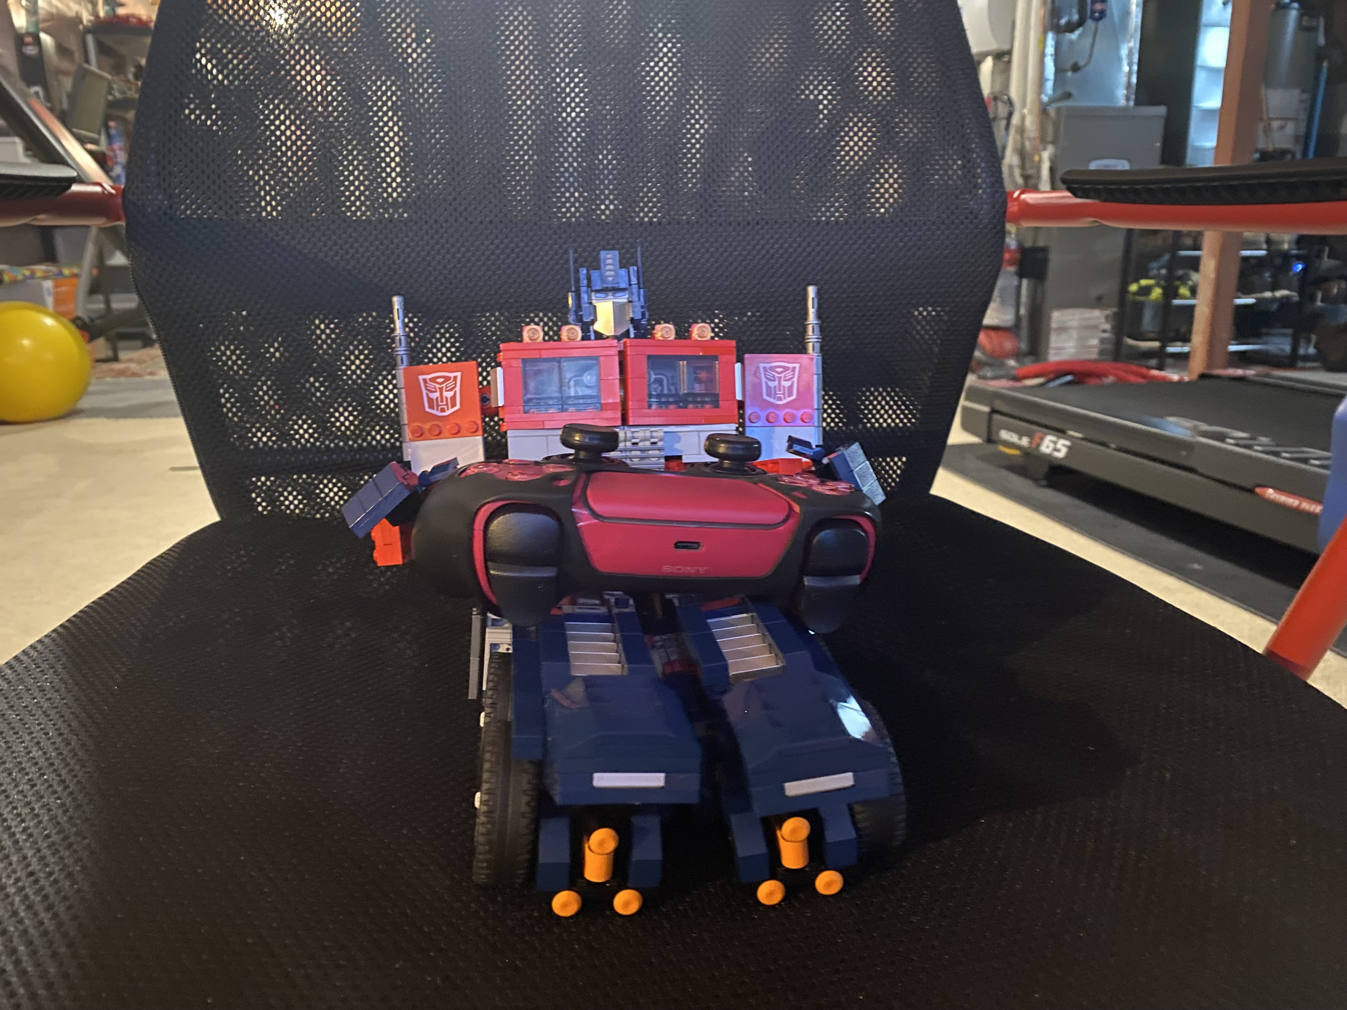
Introduction
My Name is Humza Sheikh, I am a project assistant
I work with the VR Simulation Market Assessment Team
Currently enrolled in Computer programming
My hobbies are playing video games, building Lego, watch movies/ tv shows, reading comics, cars, anime and too many list.
Notes:
My Name is Humza Sheikh, I am a project assistant
I work with the VR Simulation Market Assessment Team
Currently enrolled in Computer programming
My hobbies are playing video games, building Lego, watch movies/ tv shows, reading comics, cars, anime and too many list.

Slide 4
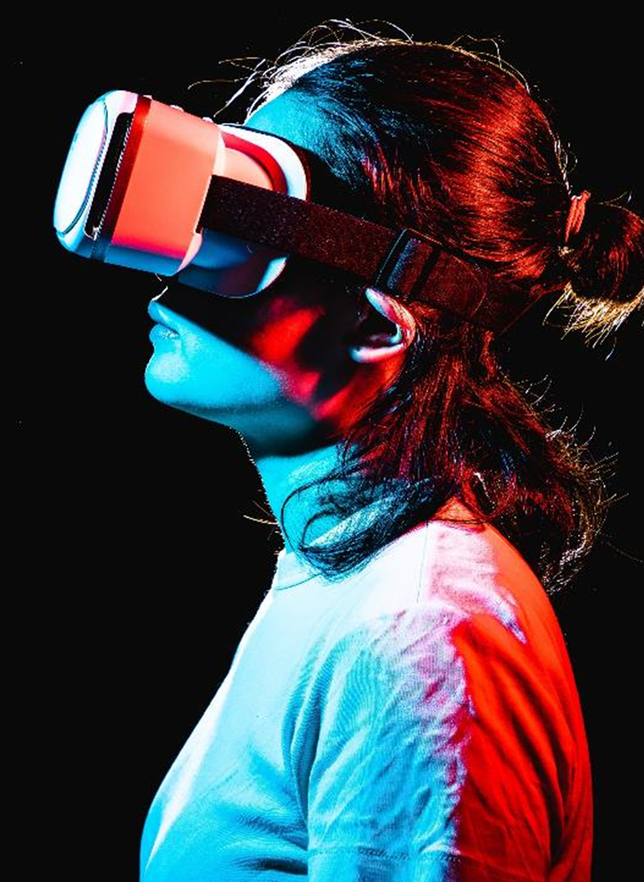
Introduction
This presentation will briefly summarize the VR market analysis report.
A market analysis report is basically a snapshot of the market and in my case, my report was snapshot of the VR gaming sector.
Focus on the market overview and growth, trends, VR gaming development companies, headsets, and the future.
Notes:
This presentation will briefly summarize the VR market analysis report.
A market analysis report is basically a snapshot of the market and in my case, my report was snapshot of the VR gaming sector.
Focus on the market overview and growth, trends, VR gaming development companies, headsets, and the future.

Slide 5
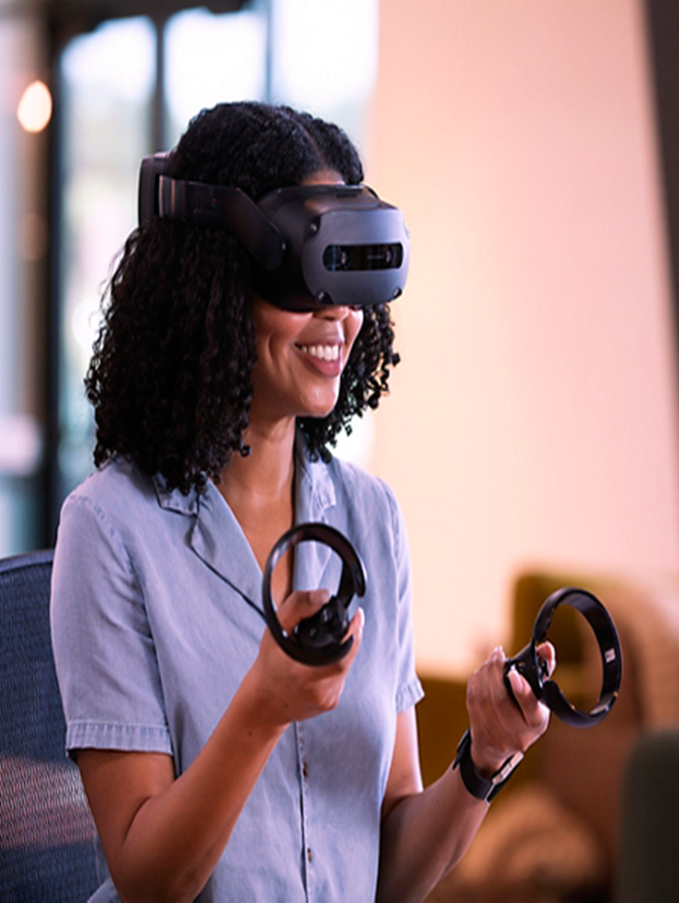
Key Findings
VR gaming market was valued at $27.25 billion (USD) in 2022.
The constant evolution of VR hardware and immersive titles will be the main driving force in growing the sector.
Highlight top ten VR gaming development companies in 2023 that pushed the industry forward.
The future looks promising, focusing on making the headset more affordable over time and accessible.
Notes:
VR gaming market was valued at $27.25 billion (USD) in 2022.
The constant evolution of VR hardware and immersive titles will be the main driving force in growing the sector.
Highlight top ten VR gaming development companies in 2023 that pushed the industry forward.
The future looks promising, focusing on making the headset more affordable over time and accessible.

Slide 6
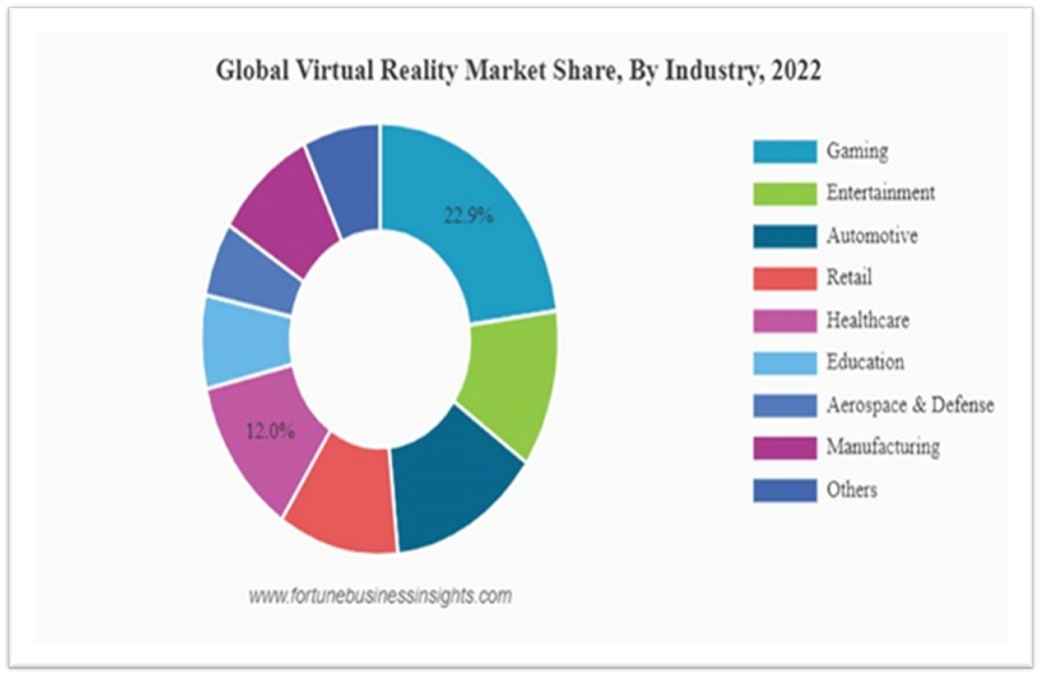
Market Overview and Growth
The gaming sector holds a 22.9% market share in the Global Virtual Reality Market in 2022.
By 2028, the market will be estimate to grow around $130.05 (USD) billion
The rapid popularity of the VR genre and big companies like Sony, Meta, Microsoft investing heavily in the sector are one of many factors that help grow the market rapidly.
Notes:
The gaming sector holds a 22.9% market share in the Global Virtual Reality Market in 2022.
By 2028, the market will be estimate to grow around $130.05 (USD) billion
The rapid popularity of the VR genre and big companies like Sony, Meta, Microsoft investing heavily in the sector are one of many factors that help grow the market rapidly.

Slide 7
Market tRENDS
The current trend, is to improve the hardware continuously and, at the same time, reduce the price as well as make it more accessible.
Future direction:
Making stronger effort in accommodating people who have disability with lighter and more comfortable headset and more accessible software for people with disabilities.
Integrate AI and machine learning in VR games.
Developing brain-computer interfaces (BCIs) which allow users to control their VR experience with their thoughts, eliminating the need for a controller.
Notes:
Market Trends:
The current trend, is to improve the hardware continuously and, at the same time, reduce the price as well as make it more accessible.
Future direction:
Making stronger effort in accommodating people who have disability with lighter and more comfortable headset and more accessible software for people with disabilities.
Integrate AI and machine learning in VR games.
Developing brain-computer interfaces (BCIs) which allow users to control their VR experience with their thoughts, eliminating the need for a controller.

Slide 8

VR Gaming Development Companies
I have highlighted two gaming development companies, if you are interest learning more, check out the full report.
Valve Corporation:
Famous and Well-Known titan of the gaming industry for developing and publisher games.
Famous for the Half-Life, portal, Left 4 Dead and many other iconic franchises.
Creating Steam: The largest digital vendor of video games.
Well-Known player in the VR industry and have been successful in creating their own VR headset
and at the same time collaborating with Hp and HTC on their respective headsets.
Notes:
I have highlighted two gaming development companies, if you are interest learning more, check out the full report.
Valve Corporation:
Famous and Well-Known titan of the gaming industry for developing and publisher games.
Famous for the Half-Life, portal, Left 4 Dead and many other iconic franchises.
Creating Steam: The largest digital vendor of video games.
Well-Known player in the VR industry and have been successful in creating their own VR headset
and at the same time collaborating with Hp and HTC on their respective headsets.

Slide 9

VR Gaming Development Companies
2. ILM X LAB:
ILM was founded by George Lucas and the company is responsible for providing outstanding special effects for more than 400 films.
Studio that was founded in 2015 by the biggest visual effects company in the business, Industrial light & Magic (ILM).
Dedicated to creating visually stunning, immersive games with their famous lp’s, Star Wars, Marvel and others.
Vader Immortal: A Star Wars VR Series and Tales from the Galaxy’s Edge are most notable and successful titles from the studio.
Notes:
ILM X LAB:
ILM was founded by George Lucas and the company is responsible for providing outstanding special effects for more than 400 films.
Studio that was founded in 2015 by the biggest visual effects company in the business, Industrial light & Magic (ILM).
Dedicated to creating visually stunning, immersive games with their famous lp’s, Star Wars, Marvel and others.
Vader Immortal: A Star Wars VR Series and Tales from the Galaxy’s Edge are most notable and successful titles from the studio.

Slide 10
VR Gaming Development Companies
Here are the other eight VR gaming development companies in 2023 who have plenty of experiences and success on creating and developing titles that push the industry forward and influence the sector.
Oculus Studio: Robo Recall
Cloudhead Games: Pistol Whip
Polyarc: Moss
Survios: Creed: Rise to Glory
Archiact: Doom 3: VR Edition
Schell Games: Among Us VR
Ready At Dawn: Lone Echo Series
Fast Travel Games: Vampire: The Masquerade Justice
Notes:
Here are the other eight gaming development companies in 2023 who have plenty of experiences and success on creating and developing titles that push the industry forward and influence the sector.
Oculus Studio: Robo Recall
Cloudhead Games: Pistol Whip
Polyarc: Moss
Survios: Creed: Rise to Glory
Archiact: Doom 3: VR Edition
Schell Games: Among Us VR
Ready At Dawn: Lone Echo Series
Fast Travel Games: Vampire: The Masquerade Justice

Slide 11


Headsets
The Meta/Oculus Quest 2 is one the most accessible headsets to start your VR journey because:
It does not require you to own a pc or console, just an app on your phone.
Includes everything you need out of the box and it’s affordable.
Valve index, Sony PSVR2, and HP Reverb G2 are great options, each with their own pros and cons.
VAR labs have plenty of experience with the Steam VR platform by developing their learning simulators.
Meta/Oculus Quest 2
Valve index
Notes:
The Meta/Oculus Quest 2 is one the most accessible headsets to start your VR journey because:
It does not require you to own a pc or console, just an app on your phone.
Includes everything you need out of the box and it’s affordable.
Valve index, Sony PSVR2, and HP Reverb G2 are great options, each with their own pros and cons.
VAR labs have plenty of experience with the Steam VR platform by developing their learning simulators.

Slide 12
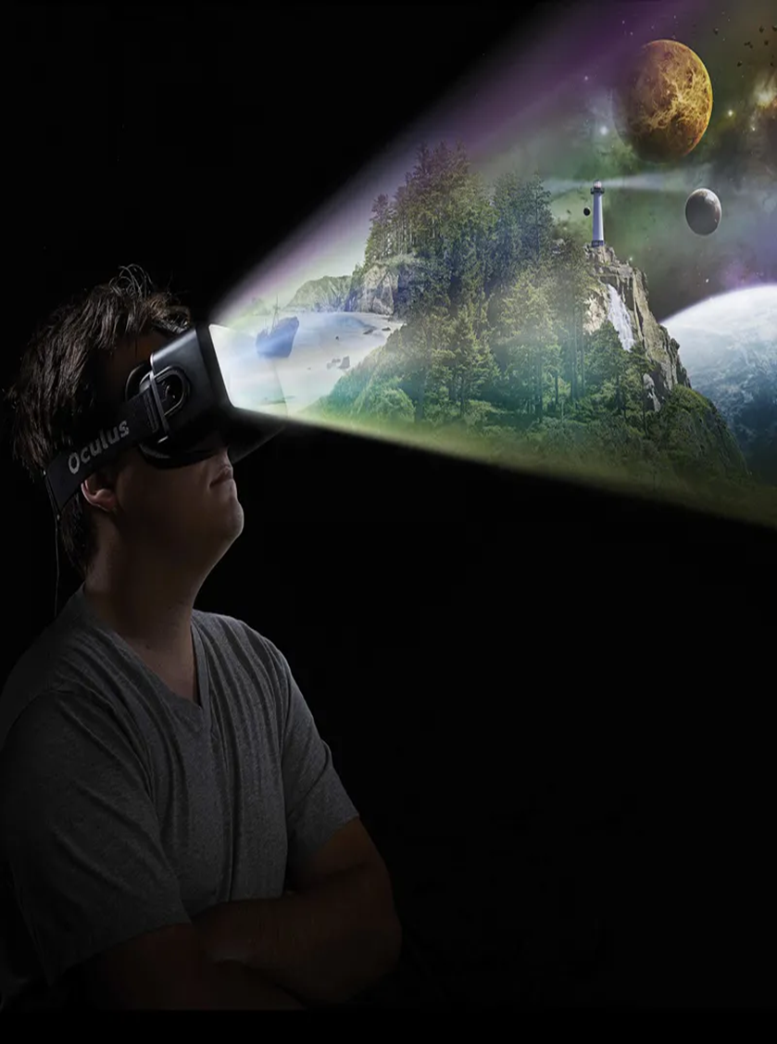
The Future/Summary
VR gaming promises an exciting future with immersive experiences and boundless possibilities for gamers.
In summary, the VR gaming market is on an upward trajectory, characterized by innovation, user demand, and the significant influence of key players and platforms.
Notes:
VR gaming promises an exciting future with immersive experiences and boundless possibilities for gamers.
In summary, the VR gaming market is on an upward trajectory, characterized by innovation, user demand, and the significant influence of key players and platforms.

Slide 13
Next Step
The next step is testing VAR Labs internal sims by recording myself reviewing it.
The first is the Trucking Inspection.
Think of the me doing a walkthrough of game but the game is Trucking Inspection, see what the sim did well, see where it can improve.
I will use the Facilitator Guides to guide me through the sim, facilitator guide basically an guide on how to navigate the sim.
Notes:
The next step is testing VAR Labs internal sims by recording myself reviewing it.
The first is the Trucking Inspection.
Think of the me doing a walkthrough of game but the game is Trucking Inspection, see what the sim did well, see where it can improve.
I will use the Facilitator Guides to guide me through the sim, facilitator guide basically an guide on how to navigate the sim.

Slide 14
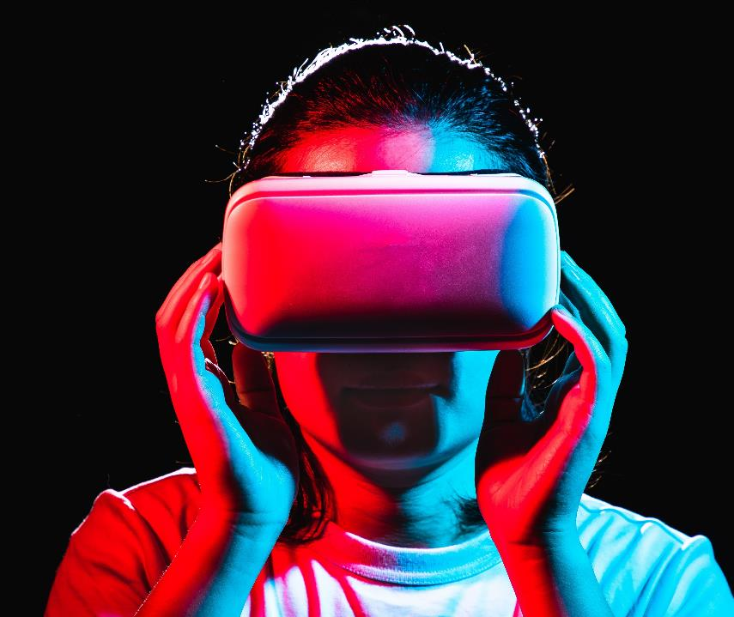
Thank you
Humza Sheikh​​
Project Assistant
hnsheikh@conestogac.on.ca

Slide 15
Questions?

Slide 16
References
Market Overview and Growth:
Expert Market Reasearch . (n.d.). Global Virtual Reality Gaming Market. Retrieved from Expert Market Reasearch : https://www.expertmarketresearch.com/reports/virtual-reality-gaming-market#:~:text=The%20global%20virtual%20reality%20gaming,USD%20130.05%20billion%20by%202028.
Market Trend:
Expert Market Reasearch . (n.d.). Global Virtual Reality Gaming Market. Retrieved from Expert Market Reasearch : https://www.expertmarketresearch.com/reports/virtual-reality-gaming-market#:~:text=The%20global%20virtual%20reality%20gaming,USD%20130.05%20billion%20by%202028.
Full Scale. (2023, May 18). Full Scale. Retrieved from 2023 Virtual Reality Development Trends, The Future is Now: https://fullscale.io/blog/virtual-reality-development-trends-2023/#:~:text=Some%20of%20these%20hardware%20improvements,%2Dcomputer%20interfaces%20(BCIs).
Key Players and Headsets:
Vionix . (2023, May 19). Top 10 VR game development companies in 2023. Retrieved from Vionix : https://vionixstudio.com/2023/05/05/top-10-vr-game-development-companies-in-2023/#Valve_Corporation
Will GreenWald, J. M. (2023, October 27). The best VR Headsets for 2023. Retrieved from PC mag: https://www.pcmag.com/picks/the-best-vr-headsets

Slide 17
References
Key Findings:
​Image #1
Headsets:
​Meta/Oculus Quest 2
​Valve Index
VR Gaming Development Companies:
​Valve Logo
ILM X Lab Logo
The Future/Summary:
​Image #1

